Slide 1



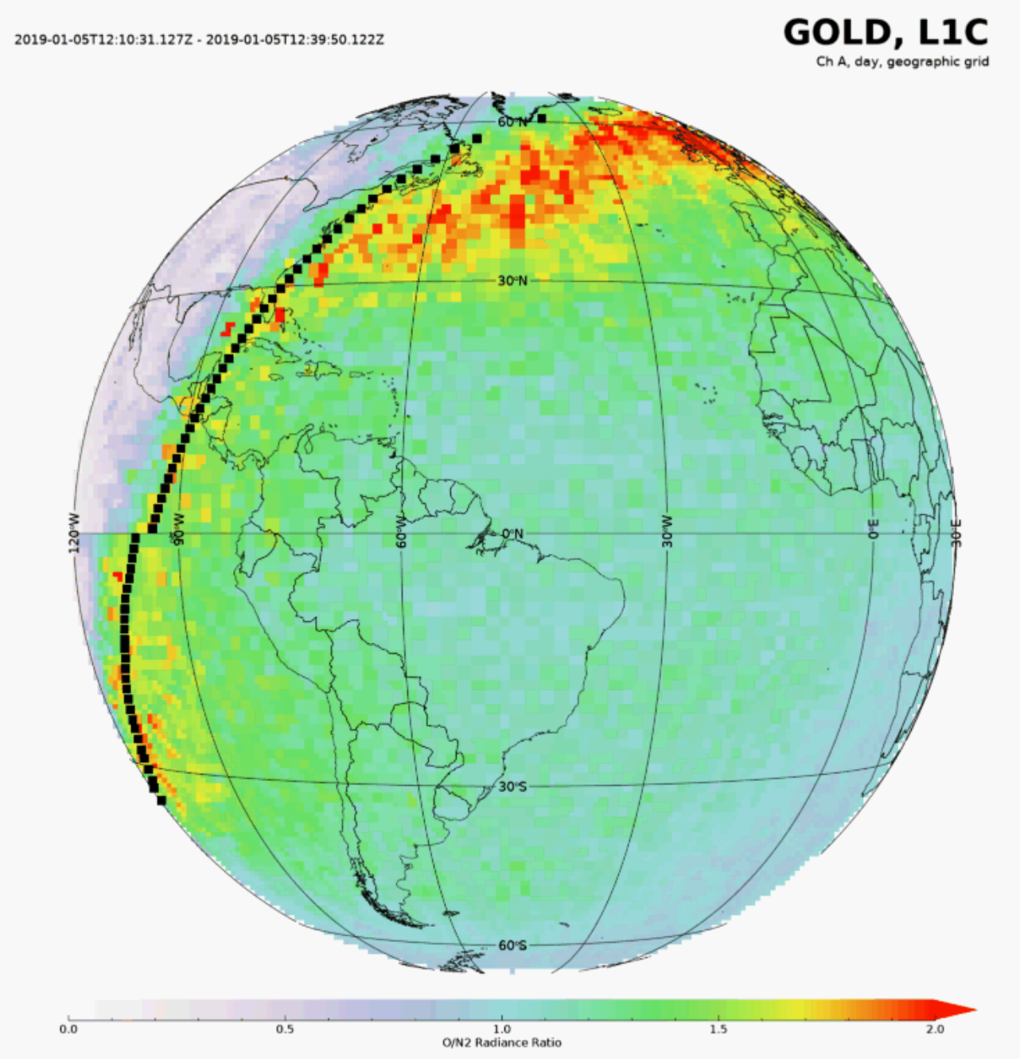
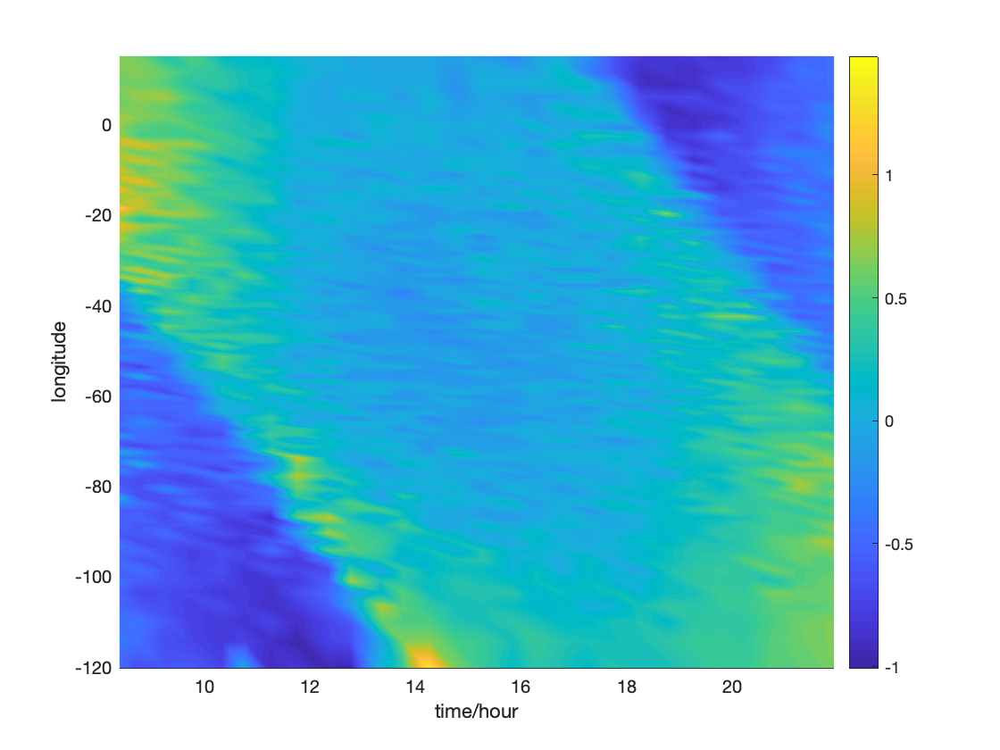
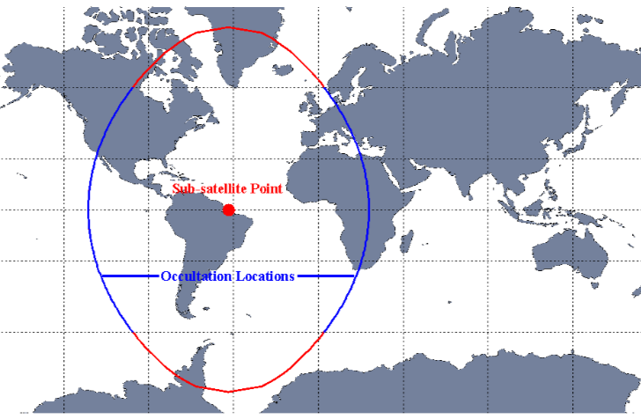
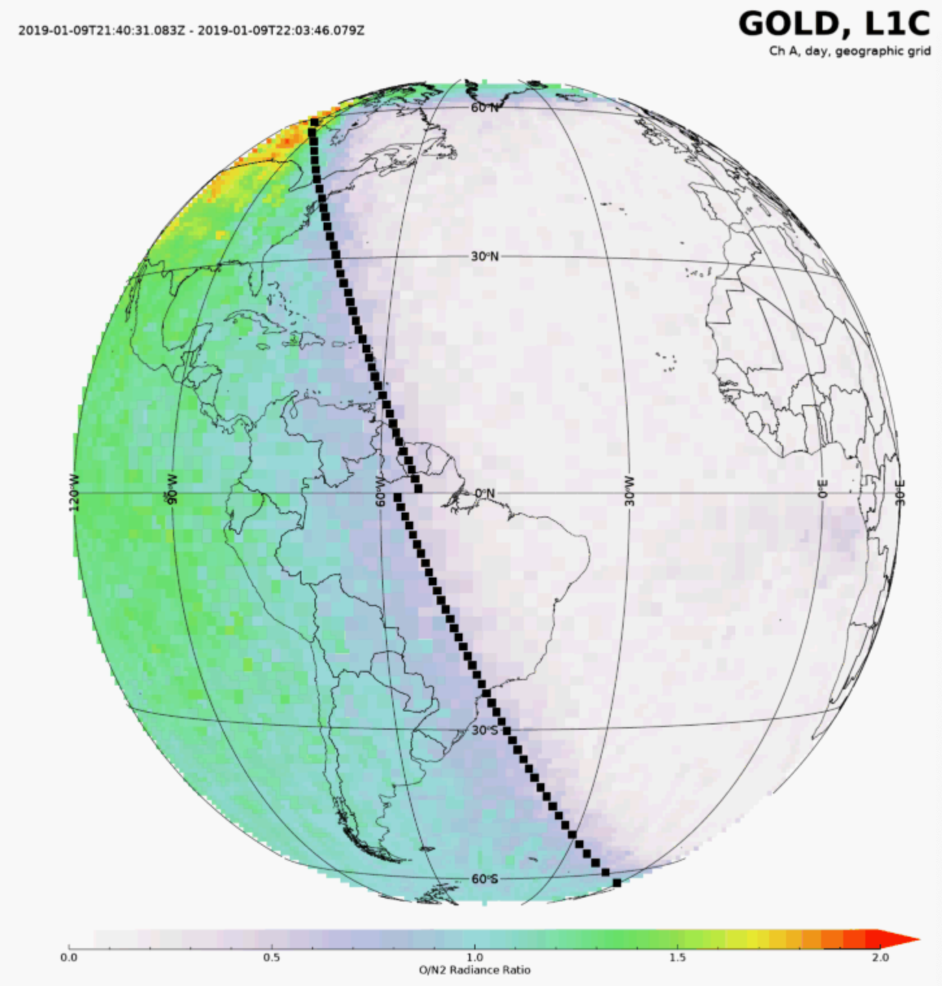
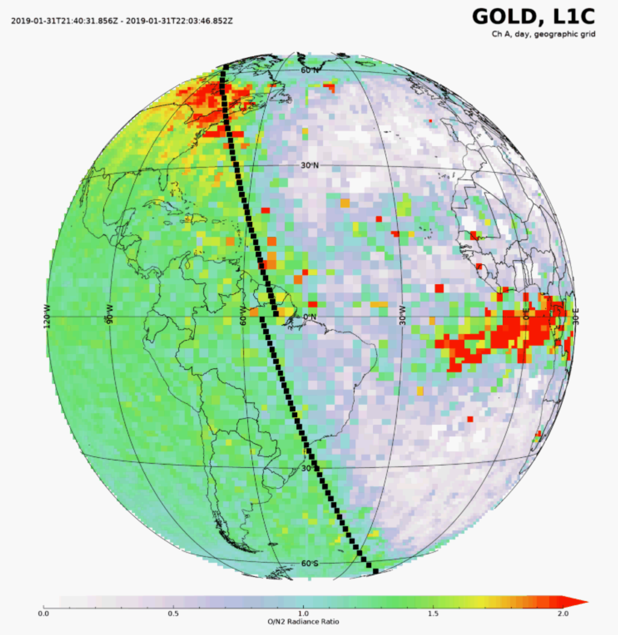
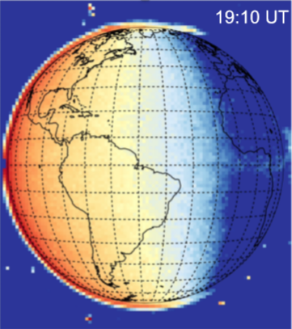
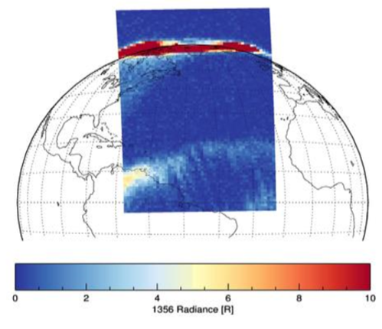
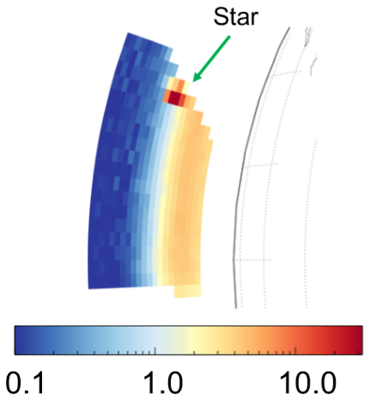
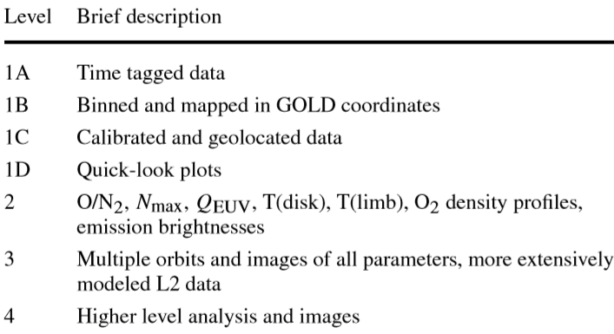
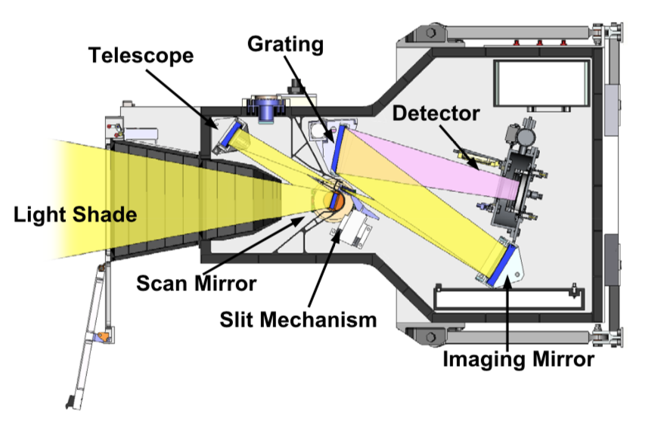
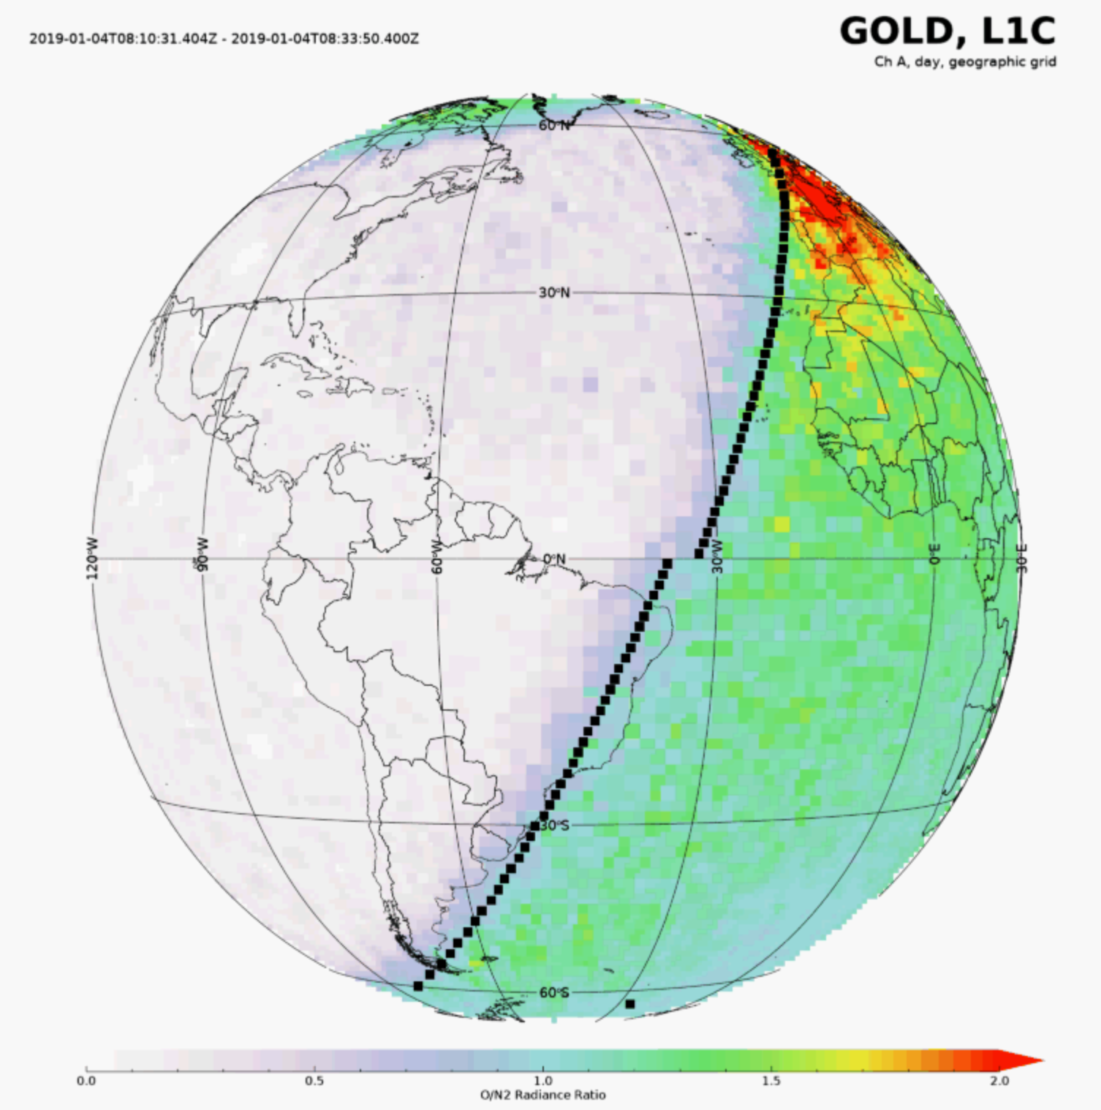
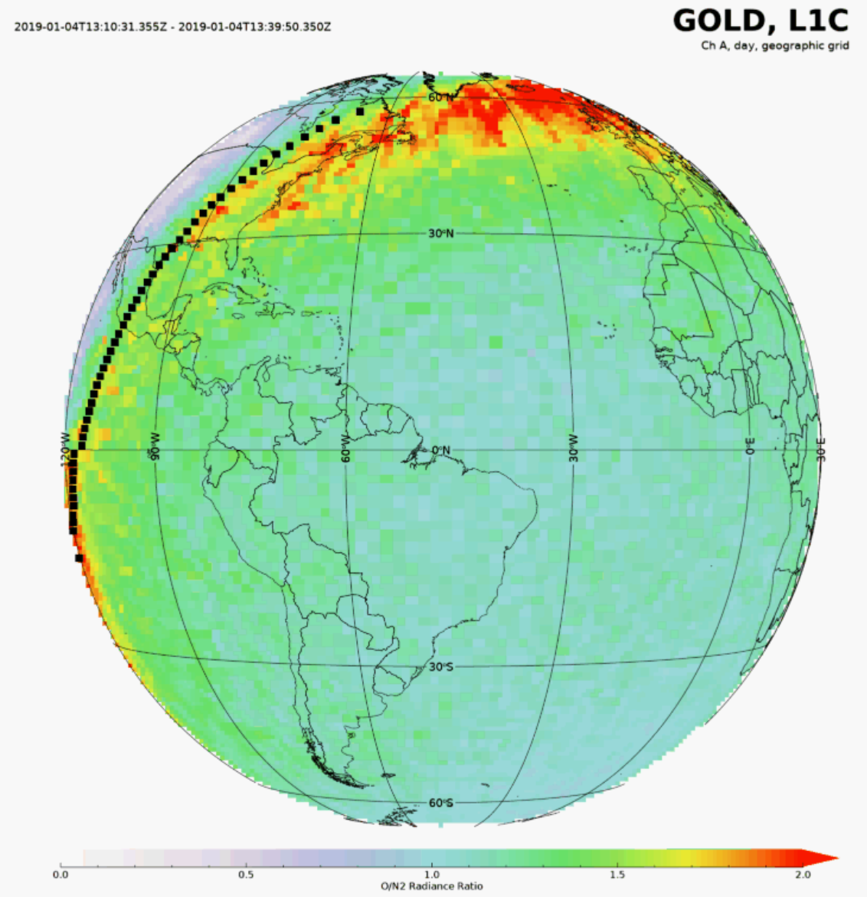
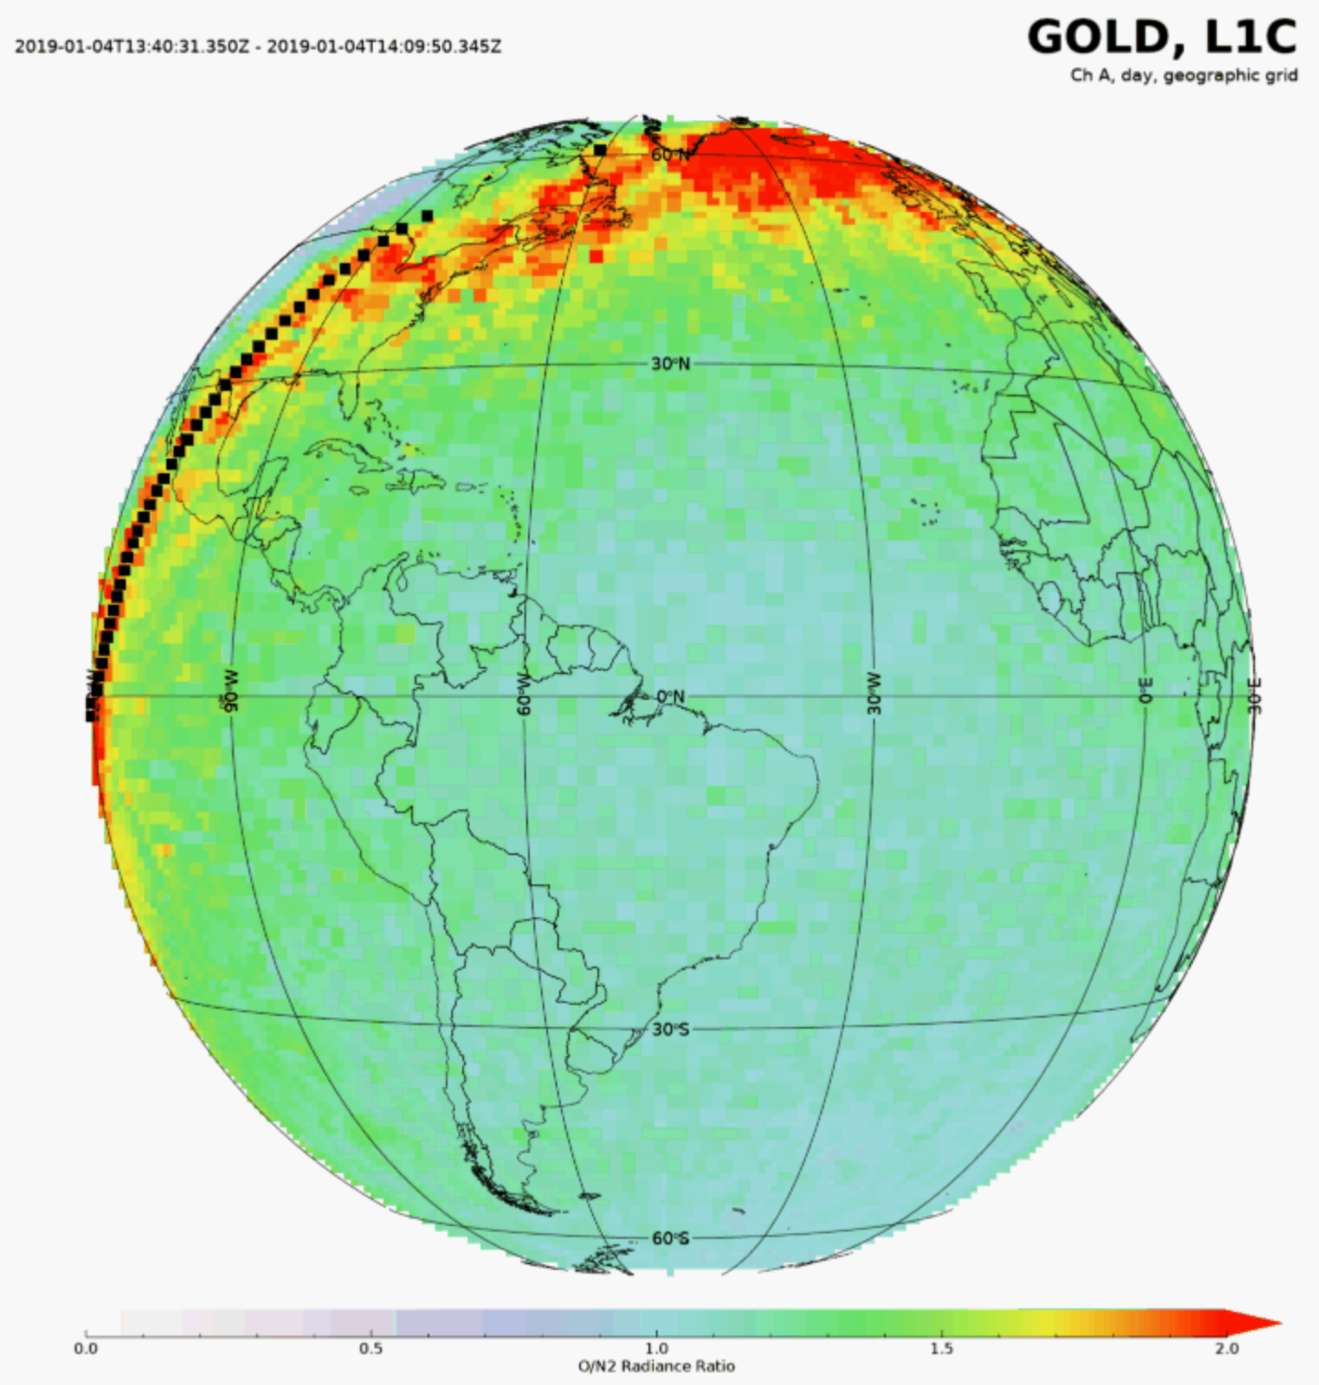
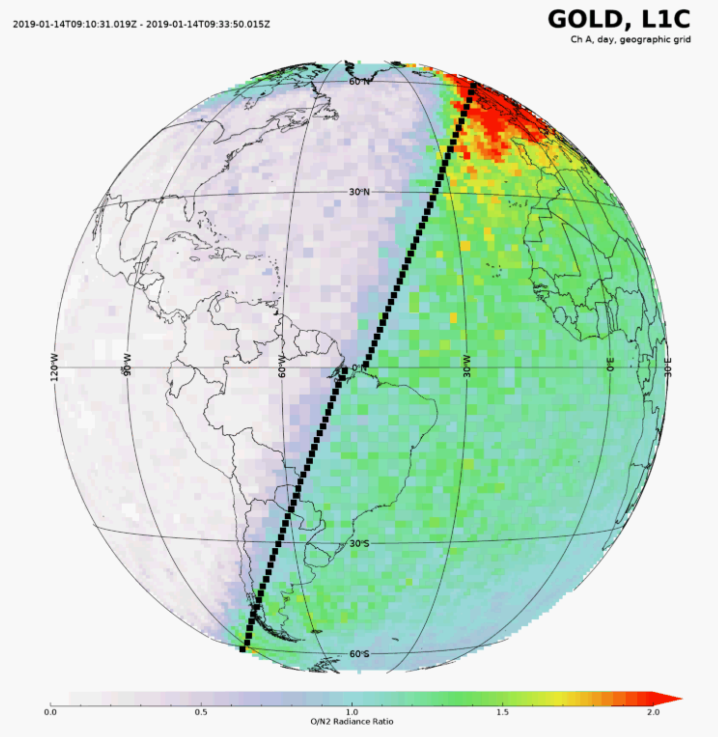
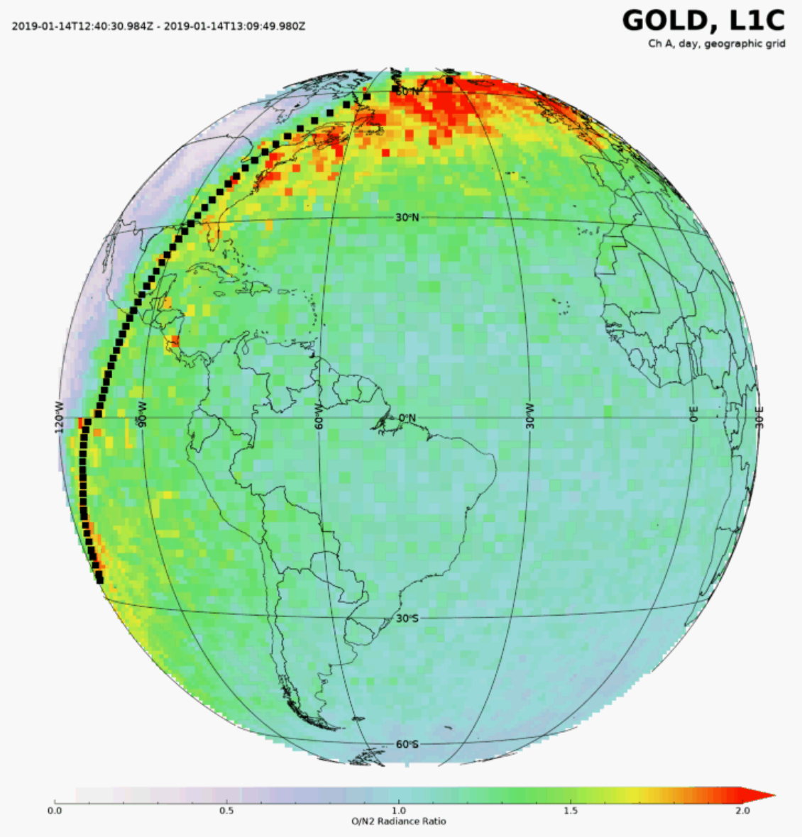
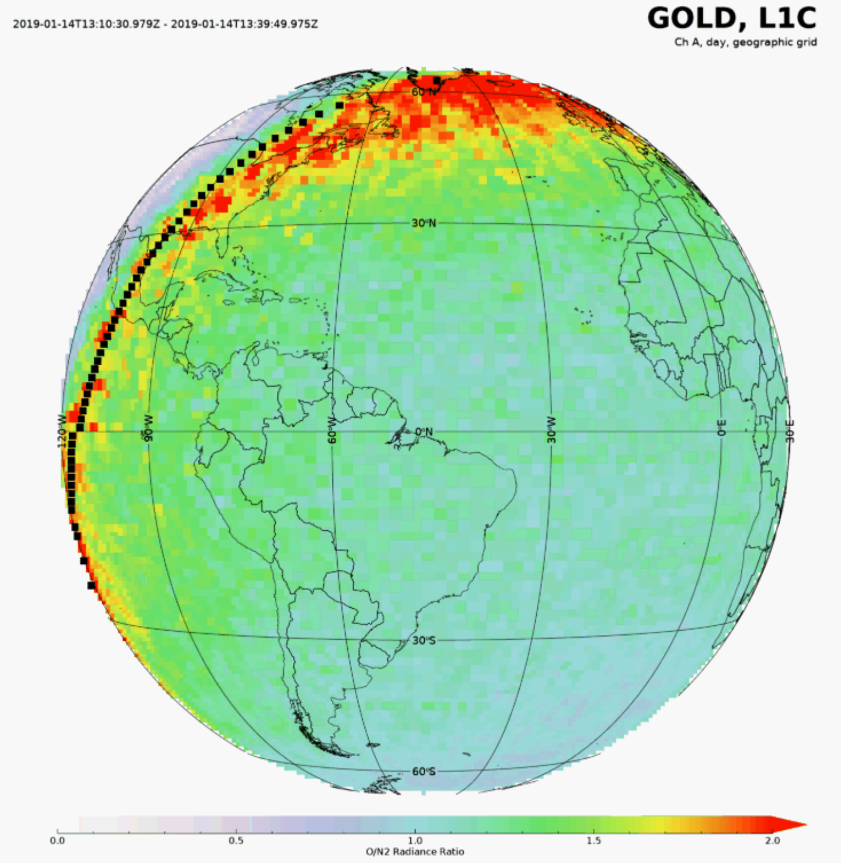
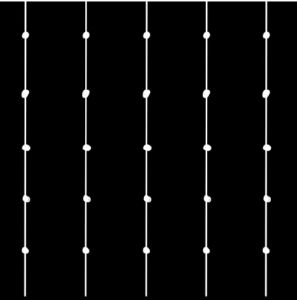
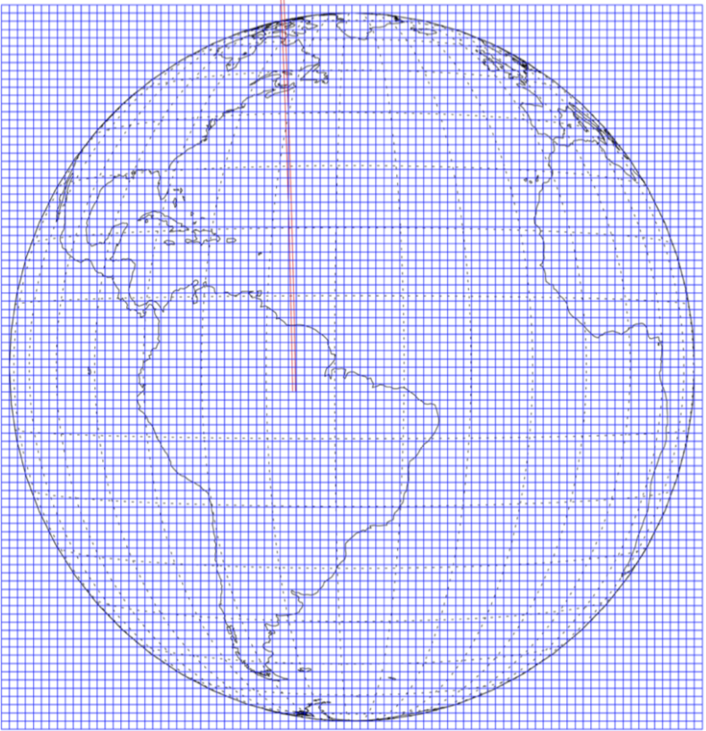
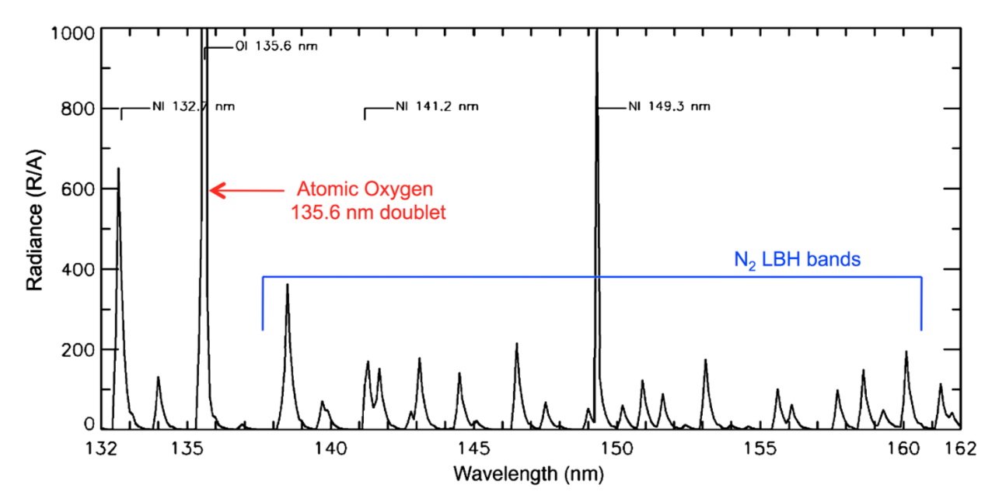
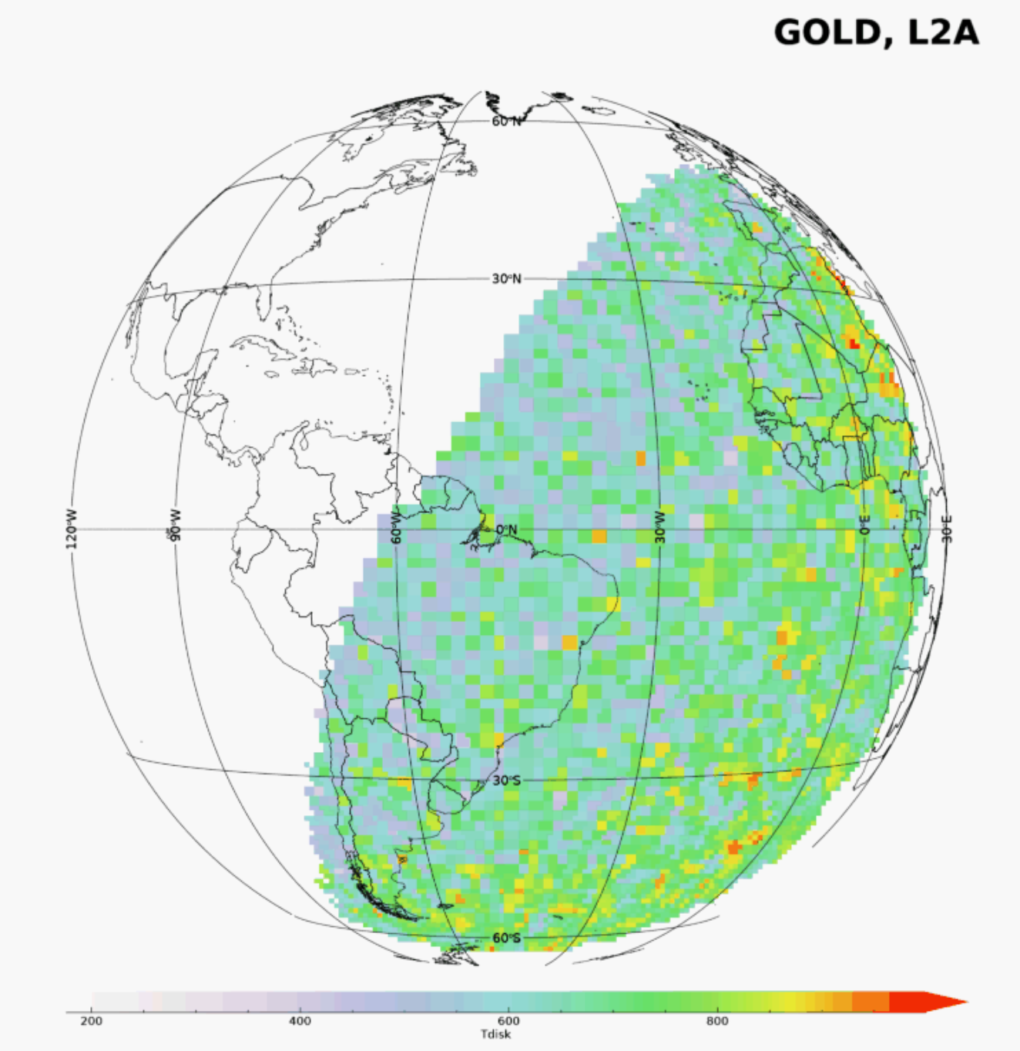
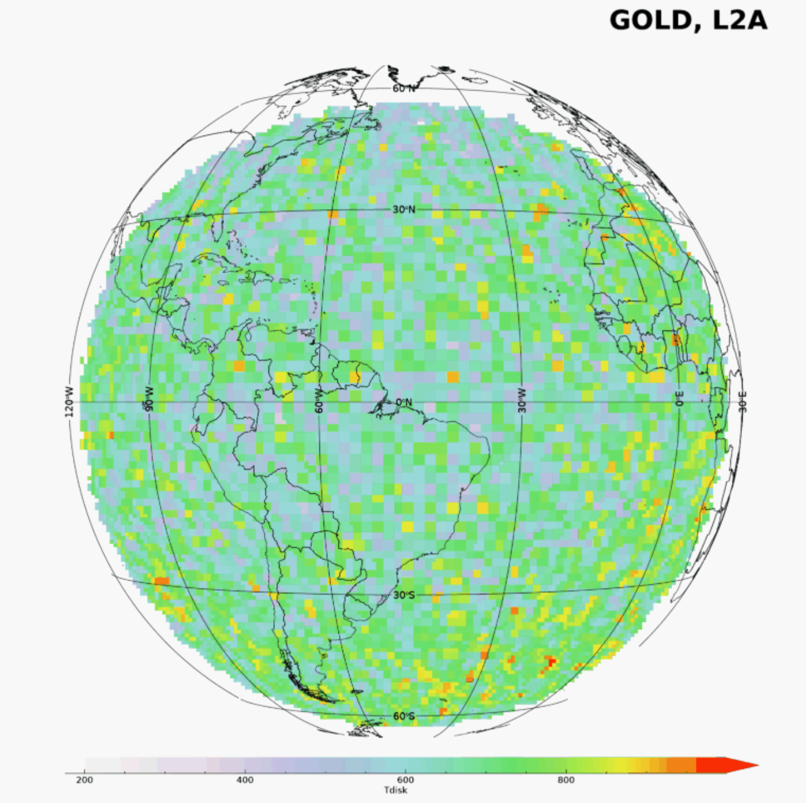
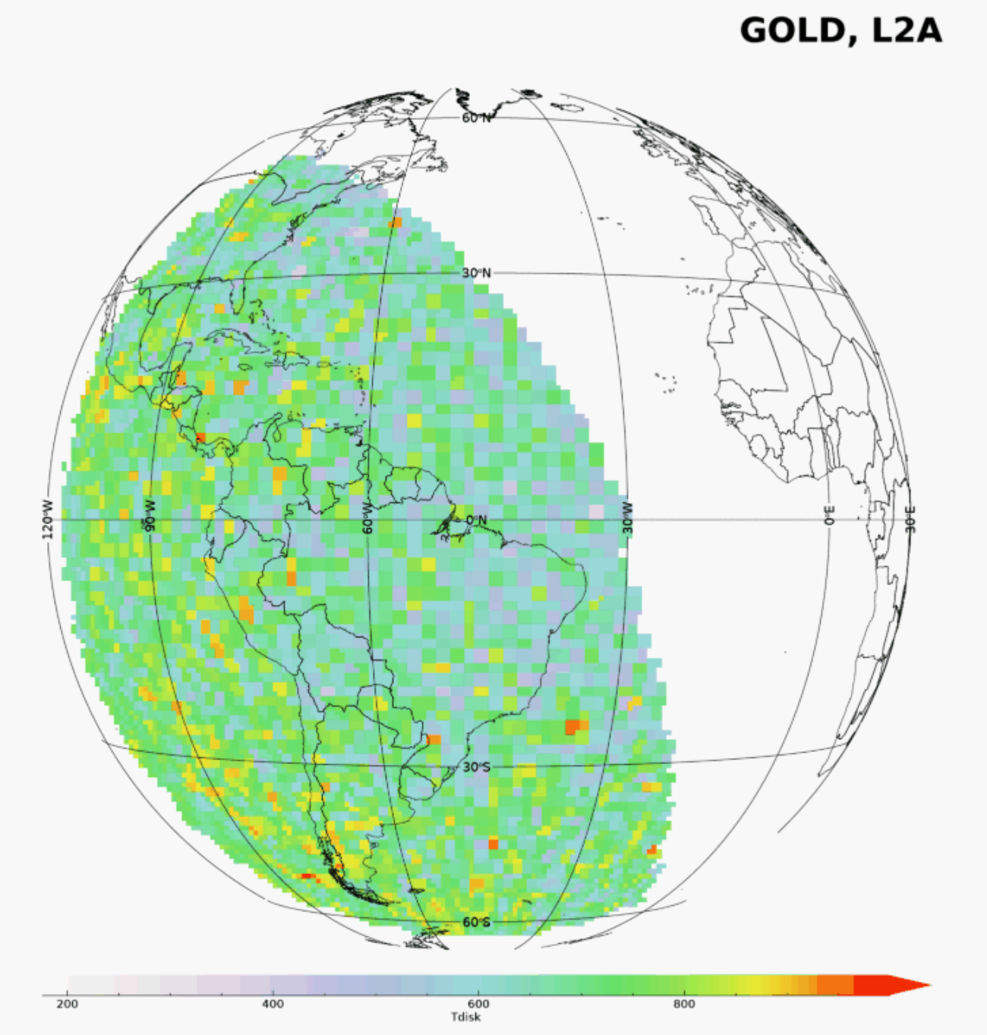
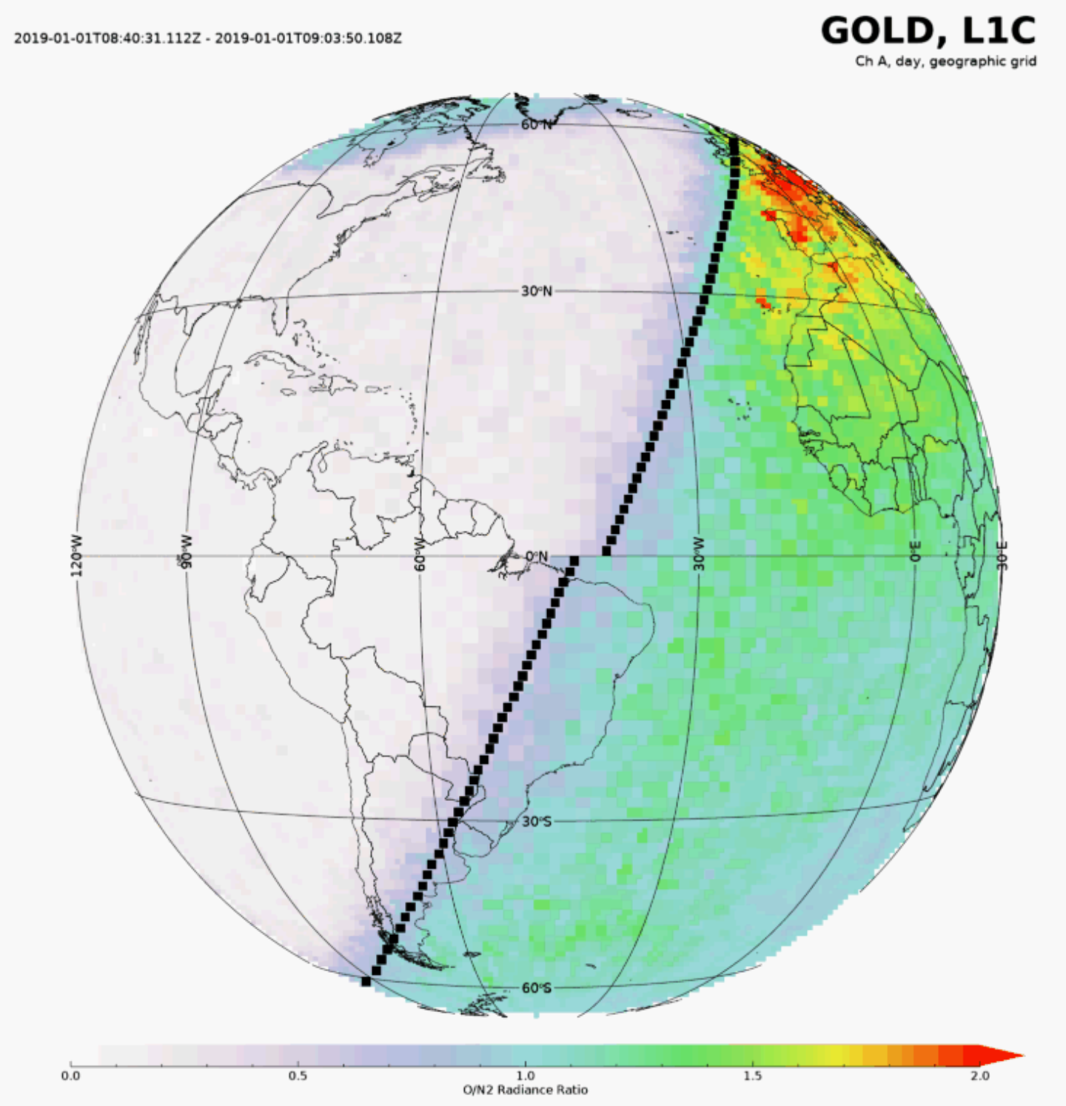
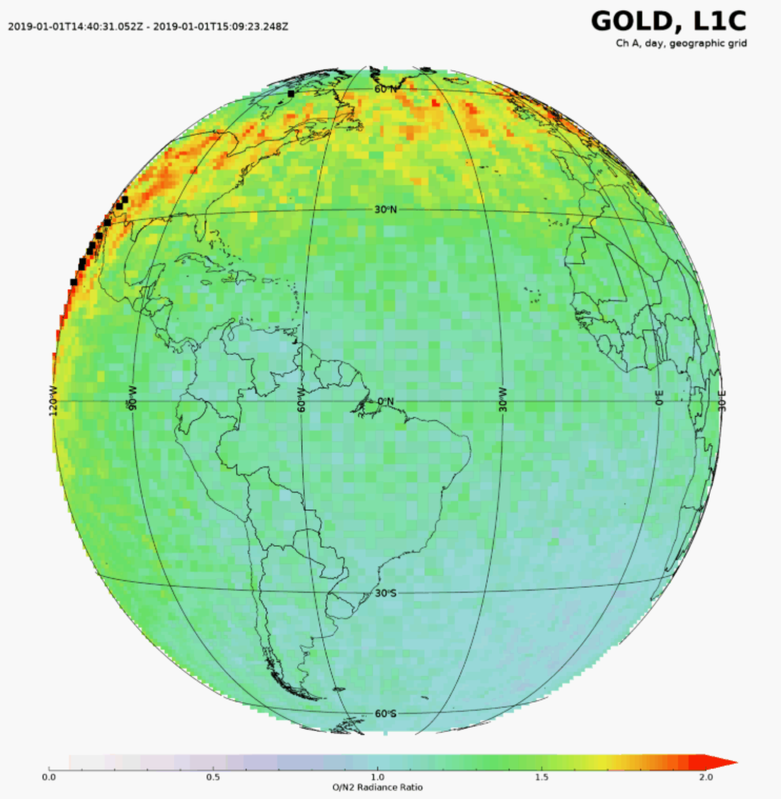
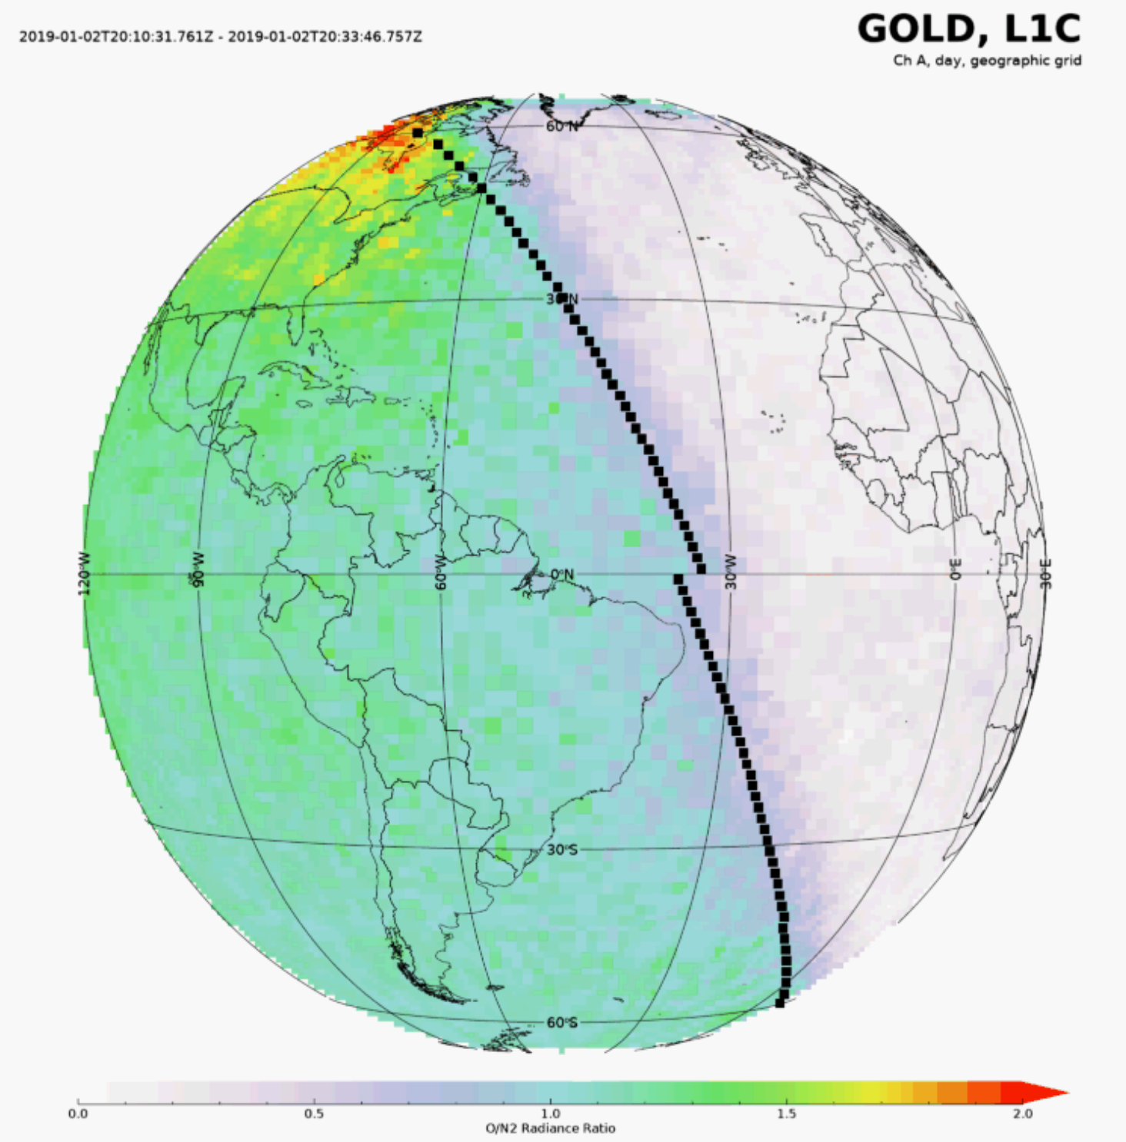
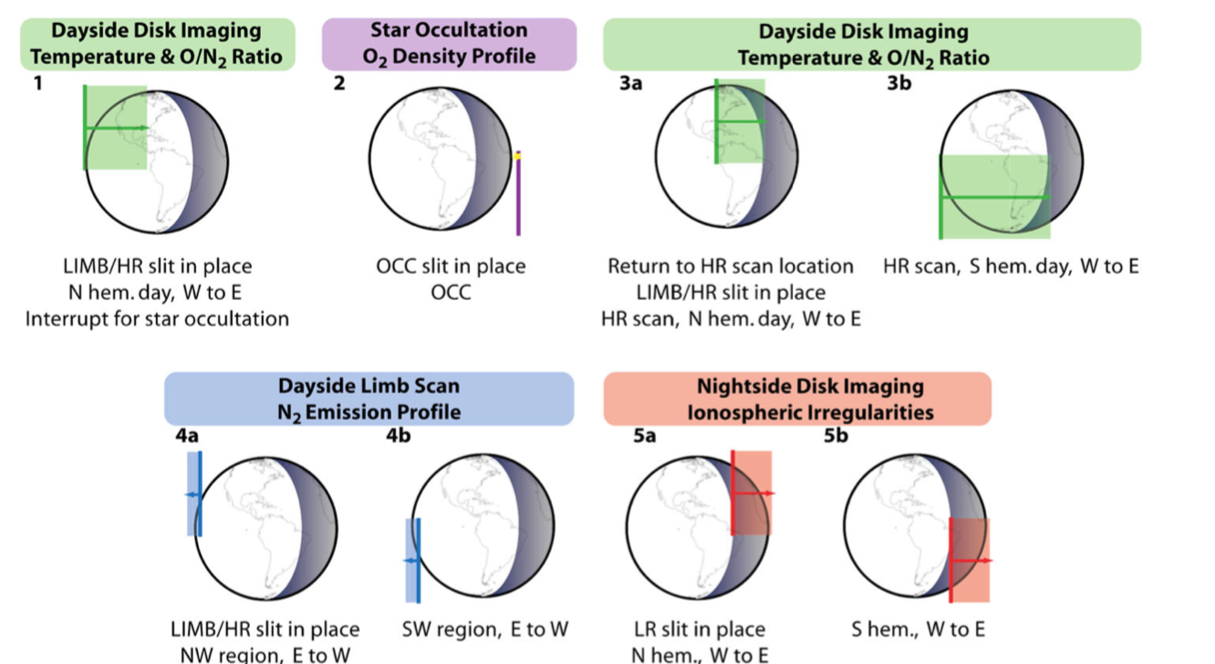
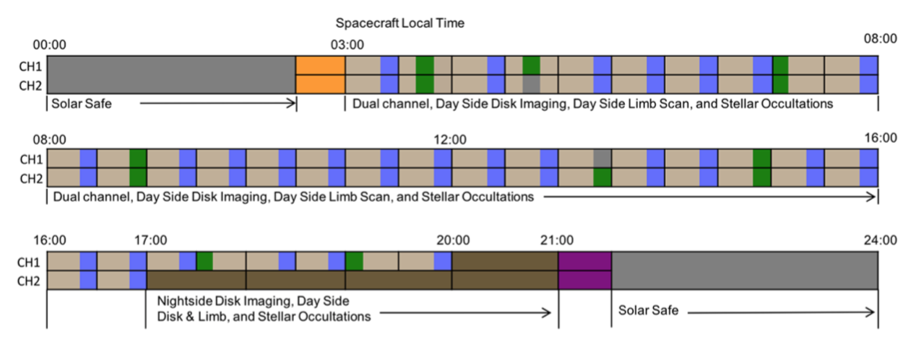
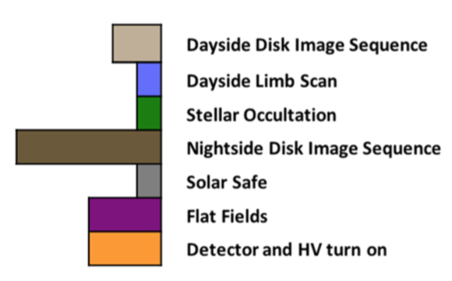
The global-scale observations of the limb and disk (GOLD) mission to explore
space weather
Y. Zhu², Visiting Undergraduate; J. Oberheide¹, Professor; X. Lu¹, Professor
¹Department of Physics and Astronomy, Clemson University ²Department of Physics , Southern University of Science and Technology; Shenzhen, China
yzhu3@clemson.edu
joberhe@g.clemson.edu
xianl@clemson.edu
Abstract Earth thermosphere and ionosphere are coupled into a highly complicated dynamic system, absorbing variances from both above and below, which makes the physics process there extremely intricate. This system would exhibit a significant response within an hour to changes in those inputs, as plasma and fluid processes compete to control its temperature, composition, and structure. Former missions had success in the sense of understanding the climatology of the T-I system, while lacking both resolution and certainty to give conclusive knowledge of the short-time variability of the system. The Global-scale Observations of the Limb and Disk (GOLD) mission will for the first time reveal how the T-I system would response to the far more dynamic change from various drivers. In its geostationary orbit, the imaging spectrograph of GOLD has the full capacity the detect the Earth’s emission ranging from 132nm to 162 nm with unprecedented high resolution. Further valuable products can be produced from raw measurements that GOLD perform, of which two variables are critical—thermospheric temperature and composition near 160 km on the dayside disk on the dayside. And on the night, the peak electron density can be obtained, which will be used to study the evolution of low latitude ionosphere. To exploit the GOLD’s great potential in exploring the space weather, the first step is to visualize the data and validate any possible scientific outcomes, this poster has extensively surveyed the O/N2 ratio as well as temperature on the dayside disk in the spring term of 2019 and found following evidence: On northern hemisphere there exists quasi-wavelike pattern which has tangible relationship with the drivers from low atmosphere, such as gravity wave; And this kind of variance tends to propagate to the terminator. The O/N2 ratio exhibits clear difference between storm period and storm-quiet period, which can be verified by previous research;
Motivation
Answer FOUR major scientific questions
Question 1 How do geomagnetic storms alter the temperature and composition structure of the thermosphere?
Question 2 What is the global-scale response of the thermosphere to solar extreme- ultraviolet variability?
Question 3 How significant are the effects of atmospheric waves and tides propagating from below on the thermospheric temperature structure?
Question4 How does the night time equatorial ionosphere influence the formation and evolution of equatorial plasma density irregularities?
Why GOLD is different?
For the first time resolve uncertainty of local time and longitude
Provide higher resolution
Contribute to really exploring space weather
3. The GOLD data products
3.1 level 1C data
binned spectrum for each grid
3.2 level 2 data and algorithm
On the dayside(at the ~150km altitude)
Temperature (Tdisk) --from LBH band structure
O to N2 density ratio(O/N2) --from the ratio of atomic O135.6nm and LBH(137nm-162nm) emission
On the nightside (at the ~150km altitude)
electron density(Nmax) --from radiative recombination of O+ resulting in area the atomic O135.6nm.
On the limb (at varying altitude)
Exospheric neutral temperature(Texo), during the day, from N2 LBH emission profiles.
O2 density profiles(O2), during day and night, from stellar occultation.
4.2 In each hemisphere, there are wave-like pattern
Fig12. 20190105 O/N2 snapshot
Fig13. 20190105 O/N2 along the 10 °N
4.3 Compare storm and quiet time, there are significant difference in both EIA and aurora region
ßßßßßœ
According to A. G. Burns et al[1995],there exists O135.6 nm emission enhancement in the EIA region
Fig1.GOLD Field of view
2. Introduction to GOLD
Fig14. 20190110 and 20190131 O/N2 storm quite and storm time
4.4 There’s a “wall-like” structure propagates to
the sunrising terminator
2.1 A geostationary orbit
As a payload the SES-14
Nadir at 47.5° W
2.2 The mechanism of one scan
A slit with holes along its length
Slit tilts to scan either hemisphere
2.3 Nominal one day scan
Three types of scan: diskscan(dayside and nightside); limb scan; occultation
Fig6.On the dayside disk
Fig7.On the nightside disk
Fig8.Limb scan and occultation
Fig9.Level description
Fig15.20190104 O/N2 evolution
Fig2.GOLD spectrograph
4. Scientific finding and explanation
Fig16.20190114 O/N2 evolution
We want to find out the variances driven by the below dynamo such as gravity waves.
Thus focusing extensively on the O/N2 and Tdisk
First logical step is to visualization
4.1 visualize
This propagation is likely to have strong correlation with the change of photochemistry near the terminator due to the sun emission gradient
Fig3.Slit ‘titls’ to form grid
Fig4.One scan for 3 dimensional array
Fig5.A spectra for each grid point
Conclusions
The GOLD, being a highly valuable geostationary satellite imager, provides an exciting new perspective for space science and enables competent capability to space weather research.
The basic method of how GOLD collects data is by scanning, includes the disk scan, limb, and occultation.
GOLD can provide imformation about temperature, composition, and electron density, which can be served as essential data to explore the status of T-I system and how it responds to various drivers.
After visualizing the Tdisk and O/N2 data, there are three notable science facts. There exists wave-like pattern in northern hemisphere; This pattern tends to move the the terminator region presumably by the changes of photochemistry; And during the storm time, both EIA region and aurora region undergo a significant enhancement.
Fig10. 20190101 Tdisk snapshot
Fig11. 20190101 O/N2 snapshot
Reference and Acknowledgement:
A.G. Burns , T. L. Killeen , G. R. Carignan , R. G. Roble, Large enhancements in the O/N2 ratio in the evening sector of the winter hemisphere during geomagnetic storms. J. Geophysics. Res. 100, A8, 14661-14671(1995) doi:10.1029/94JA03235
R.W. Eastes , W.E. McClintock, A.G. Burns, D.N. Anderson, L. Andersson, M. Codrescu, J.T. Correira, R.E. Daniell, S.L. England, J.S. Evans, J. Harvey, A. Krywonos, J.D. Lumpe, A.D. Richmond, D.W. Rusch, O. Siegmund,
S.C. Solomon, D.J. Strickland, T.N. Woods, A. Aksnes, S.A. Budzien, K.F. Dymond, F.G. Eparvier, C.R. Martinis, J.Oberheide, The Global-Scale Observations of the Limb and Disk (GOLD) Mission. Space Sci Rev, 212, 1-2, 383–408(2017), doi:10.1007/s11214-017-0392-2
Fig7.Nominal one day scan
Fig6.schematic diagram for three types of scan

